Slide 1
THRIVE Customer Service
Managers - 2024
osaic.com
Notes:
At the onset of putting together the Frontline Leadership Program, we met with Tim, Jeff and Daniel to present THRIVE as the New Customer Service Training. They liked using THRIVE as our model. Once we got their approval, I started rolling out THRIVE in our New Hire Training. One important thing is that we all speak the same language as we Work Together as One.

Slide 2
Objectives
Introduction of the new THRIVE Customer Service Training
Identify and Connect the principals of THRIVE to internal and external clients
Practice using THRIVE to empower your team to thrive
THRIVE Customer Service
Notes:
First, what we will do is I’m going to give you a high-level introduction of THRIVE Customer Service. I have activities and videos that I use during New Hire Customer Service Training that we will not do today. I try to keep it lively and fun!
Can anyone guess why I choose THRIVE?
The second thing that we will do is get you to begin to think about how the principals of thrive relate to your team. So, as we go through THRIVE think about this.
Third, your customer is not just the FP but your customer is also your team. We will do an activity where you will have the opportunity to use what you learn about THRIVE Customer Service
I want this to be as interactive as possible. One of the most powerful things I believe we all have is our VOICE. Your voice is important. You all have a wealth of knowledge that will add value to this session. There are things that you will hopefully learn from each other. I’m looking forward to your input

Slide 3
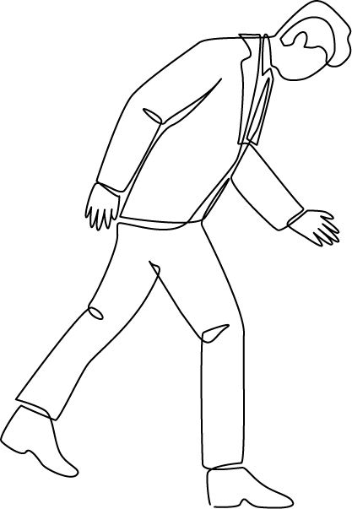
Expectations
Managers
Customers
THRIVE Customer Service
Notes:
A huge part of customer service revolves around expectations. Let’s talk for just one minute about expectations.
Think about a time you went shopping at a store or a time you placed an order online……. What were your expectations? Now let the class give a few examples.

Slide 4
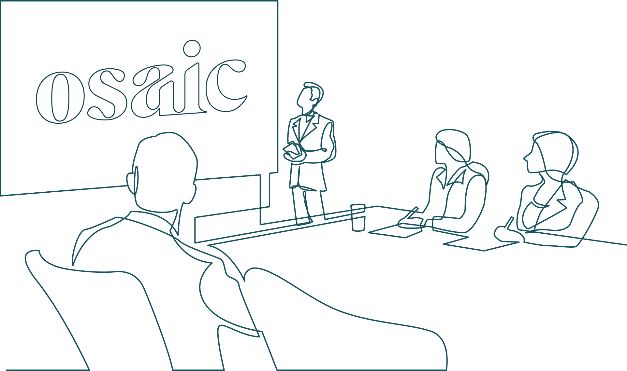
Empowering Clients
THRIVE Customer Service
Notes:
At Osaic we support over 10,000 financial professionals who rely on us to help and support them to make a difference in your clients’ lives – We have BLANK AMOUNT OF EMPLOYEES…………approximately 2400 employees
Empowering our clients to thrive begins before you interact with them
It begins before you start work. And, it has to be genuine.
It’s important to that we get excited about our day! And that we get excited about what we do!
Tell a story of Tim- when I worked in a call center.
He was getting everyone excited to make someone’s day!
Ask: “How do you begin your day?”
Transition
SAY: Let’s talk about interacting with the client. This can be an internal or external client.
SAY: I need 7 volunteers to explain each of these and why it’s important.

Slide 5
Customer Interaction
Seven Elements:
Tone of voice
Listening carefully
Speaking professionally
Language
Effective questioning
Rapport building
Setting Expectations
THRIVE Customer Service
Notes:
SAY: Let’s talk about interacting with the client. This can be an internal or external client.
Say: I need 7 volunteers to explain each of these and why it’s important.
There are 7 elements that every customer interaction should include:
Tone of voice
Listening carefully
Speaking professionally
Language
Effective questioning
Rapport building
Setting expectations

Slide 6
THRIVE Customer Service

Slide 7
T
Trust
H
Hearing
R
Results
I
Innovative
V
Value
E
E
Empower
THRIVE Customer Service
Notes:
THRIVE is our model for Client Service here at Osaic. To empower our customers to thrive:
Their needs to be trust. They are trusting Osaic with their business
Our clients needs to know that they are heard
We need to be solution oriented and at the end of the interaction we provide results
We should be innovative in our thinking and actions
We must provide value to our clients, and they must know that we value them
We are here to empower them to thrive

Slide 8
TRUST
DO WHAT'S RIGHT ALWAYS
Notes:
Trust
DO WHAT'S RIGHT ALWAYS
We are authentic and honest even when it's hard.
THRIVE is connected to our Core Values.
DO WHAT'S RIGHT ALWAYS is one of our core values at Osaic
What are consequences when someone feels like they cannot trust you?

Slide 9
Trust
Commitment
Competent
Confidence
Care
THRIVE Customer Service
Notes:
How many of you have ever played a team sport? Ask who? Let a few people tell which sport they played. .---- They sport can put in the chat what sport they played.
Say: When you look at these 4 C’s do you think that they are important when being a team?
We are on the financial professional’s team. We work with them to help them THRIVE.
Now let’s take a look at each of these
Each table give example of situation of each

Slide 10
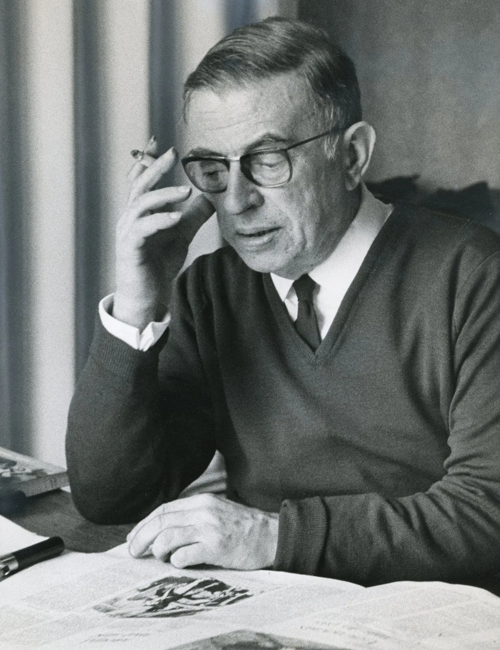
Commitment
“Commitment is an act, not a word.”
- Jean Paul Sarte
Notes:
Do: Have Group A discuss this video and how it relates to service and trust
https://youtu.be/4nKwUofo2Xk?si=xQLaAWJI_qUr14g8

Slide 11
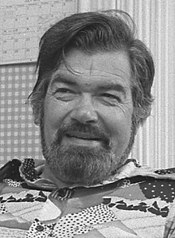
Competent
“Competence, like truth, beauty, and contact lenses, is in the eye of the beholder.”
- Laurence J Peter
Knowledge
Skill
Judgement
Problem Solving
Notes:
Do: Have Group B rate these four items and explain why?

Slide 12
Confident
“The most beautiful thing you can wear is confidence.”
- Blake Lively
Notes:
Do: Have Group C compose the 5 top things in our business we can do to depict confidence.

Slide 13
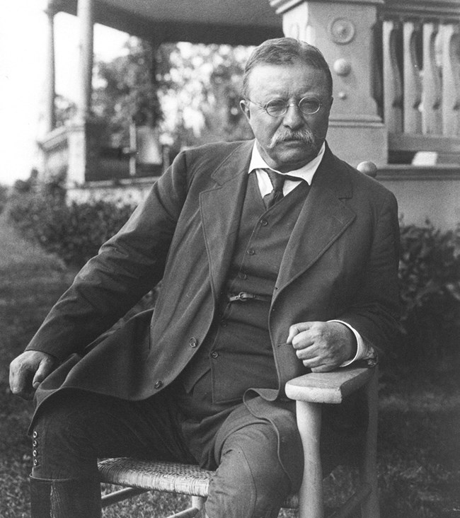
Care
“People don't care how much you know until they know how much you care.”
- Theodore Roosevelt
Appreciation
Accountability
Listening
Notes:
CARE is about an EXPERIENCE - How YOU MAKE SOMEONE FEEL
Two companies that stick out to me that show they care through how they provide service are Walt Disney and Chick- fil- A. According to Newsweek Disney Cruise Line ranks #1 in customer service overall. This is counting all businesses. The #1 fast food is Chick- fil- A. ( I’ll talk about both, ask if anyone has been to either? Ask about their experience. I will talk about my experience. ) What each of these companies do very well is provide an Exceptional Experience! Our goal is to create a culture where we are EMPOWERING OUR CUSTOMER TO THRIVE

Slide 14
HEARING
…
Notes:
Hearing
People need to know that they are being heard and that we are listening. Whether we are face to face, in a Zoom meeting or on the phone.

Slide 15
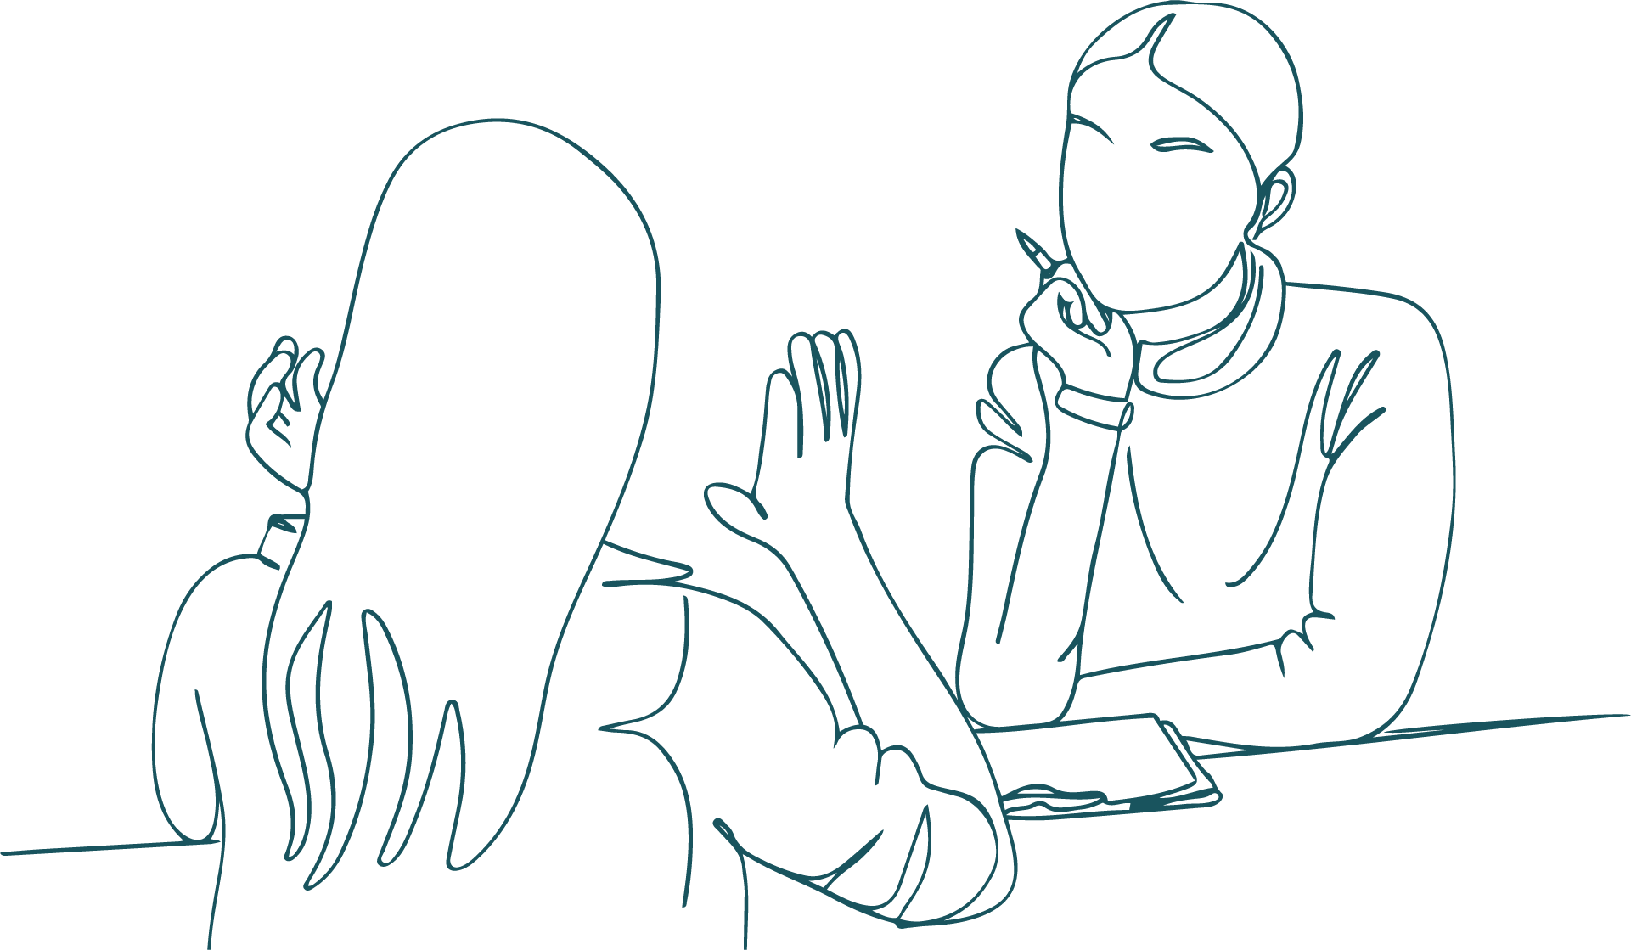
Simply Listen
Avoid distractions
Don't multitask
Listen to what their saying
Listen to the whole situation & take notes
Don't interrupt or finish their sentence
Don't make assumptions
THRIVE Customer Service
Notes:
Simply Listen
I’m going to read you something and I want you to listen. Don’t take any notes. Put down your pen/pencil, notepad etc. Simply listen.
Mr. St. Cloud called on Monday because he wanted to how to help Mrs. Downey. Mrs. Downey’s grandfather passed away on July 21. He did not have any transfer on death instructions. He had thirteen grandchildren and he wanted all of them to have equal shares of his assets besides Phillip and Mary Beth. He had taken care of Phillip for most of his life, and he did not think that Phillip would be able to handle the money. He did leave this particular grandson his vacation home in Jupiter, Florida. Mrs. Downey was devastated that her grandfather did not leave her most admired cousin any money. She was not too concerned about Mary Beth because she was married to the founder of one of the most used apps. However, she did want to know how each of the grandchildren could get equal shares.
Say: Here are some principals about listening. Let’s talk about these. Who wants to begin with Avoiding Distractions ?
Let’s talk about consequences of each. I need videos.
Avoid distractions
Don't multitask
Listen to and concentrate on what their saying—don't think about how you're going to respond while they're still speaking
Listen to the whole situation and take notes
Don't interrupt or finish their sentence
Don't make assumptions

Slide 16
Active Listening
Notes:
(253) The Big Bang Theory - Please pass the butter!! - YouTube

Slide 17
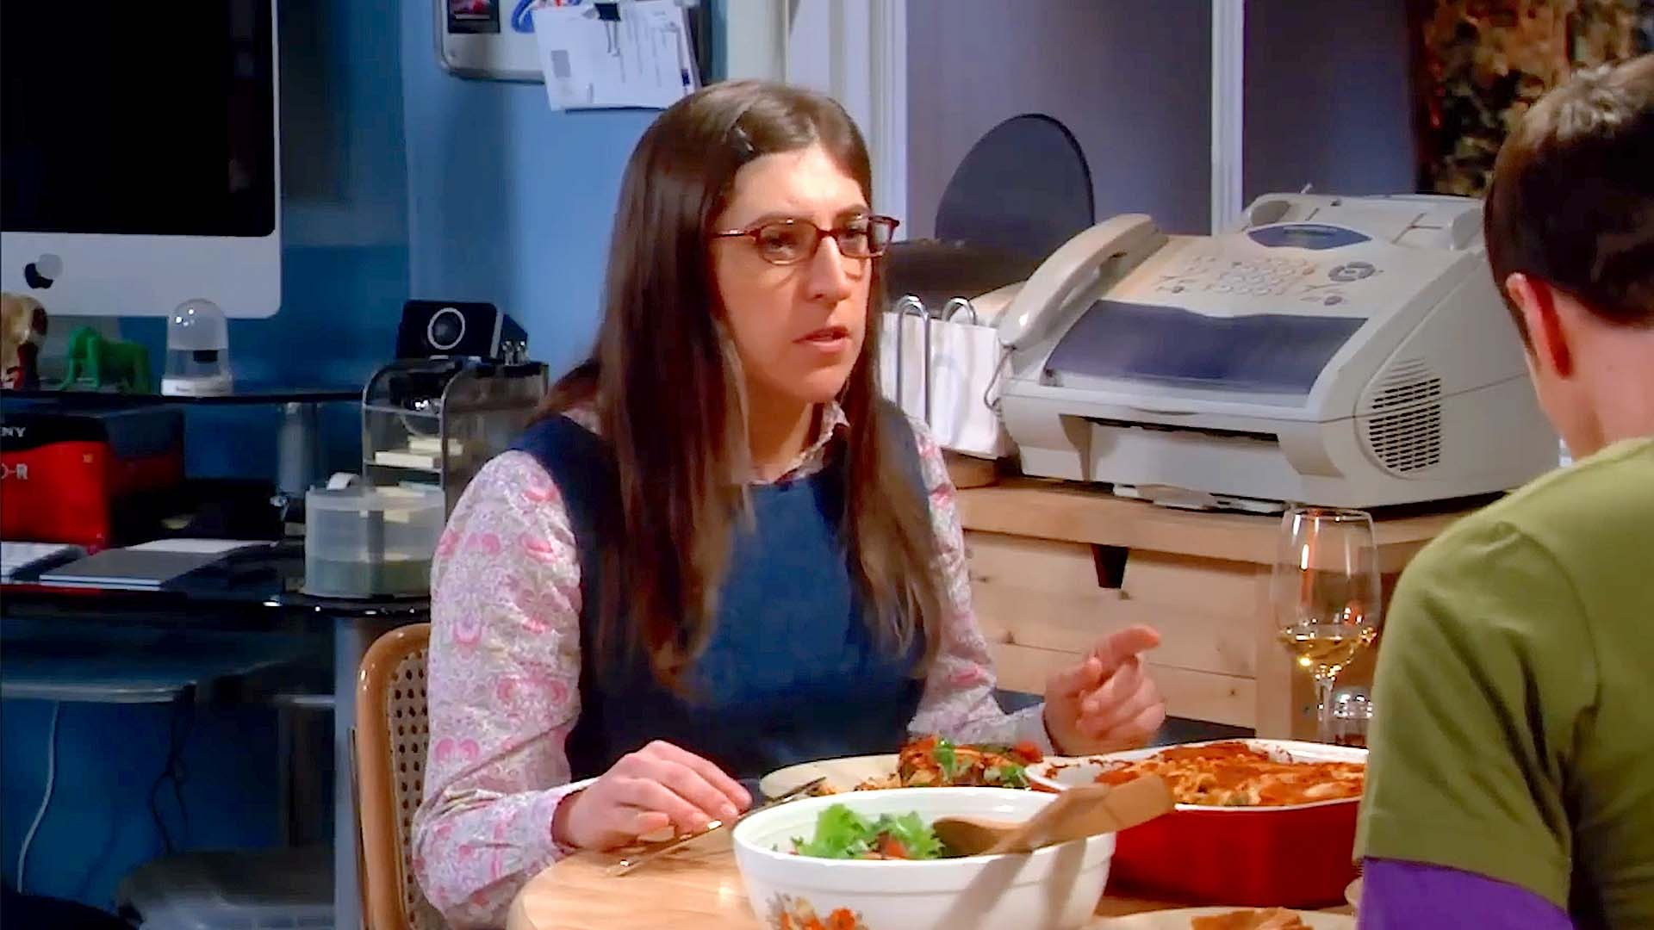
Active Listening
THRIVE Customer Service
Notes:
(253) The Big Bang Theory - Please pass the butter!! - YouTube

Slide 18
RESULTS
SHOW UP EVERY TIME
Notes:
RESULTS
Show Up Every Time
We are accountable and dependable, no excuses.

Slide 19
Results
THRIVE Customer Service
Notes:
Does this say show up sometimes? No we have to show up for every call, for every document we process etc. Because our clients are looking for results.
What happens when we don’t?

Slide 20
INNOVATIVE
THINK BIG AND SMALL
Notes:
INNOVATIVE
THINK BIG AND SMALL
We are exciting and innovative but always thoughtful.
Let’s talk about being innovative. What does this mean to you?
You will find that you may have more than one way of finding the answer. Or sometimes you have to think outside the box to find a resolution or simply help the customer without breaking any rules. I think innovation starts with Taking Ownership. Let’s talk about this for a minute.

Slide 21
Never say ‘No’ or ‘Never’
THRIVE Customer Service
Notes:
Never say never or No is being accountable and taking ownership
How do you feel when someone tells you they can’t . They don’t know how to?
Tell me about a time when you were the customer, and someone said No or that’s not my job How did you feel ?

Slide 22
What can you say?
THRIVE Customer Service
Notes:
We just talked about not just outright saying no. Does this mean you will have all the answers?
As a group I’d like for you to begin to think about what you can say.
Do: Divide the team into 2-5 groups depending upon the amount of learners in the class.
You can take this information back as a great coaching opportunity to help your team focus on what they can do.

Slide 23
VALUE
…
Notes:
VALUE
A part of taking ownership is value. Think about when you rent a car
When you own something, you take care of it – rent a car, they let you bring it back unclean, they maintain it – when you are paying the car note
When you own something, it has value to you
Value our customers- Appreciate their business

Slide 24
Empathetic
You can be empathetic by listening with intent and personalize your services to the unique needs of others.
THRIVE Customer Service
Notes:
Part of valuing our customer is being Empathetic

Slide 25
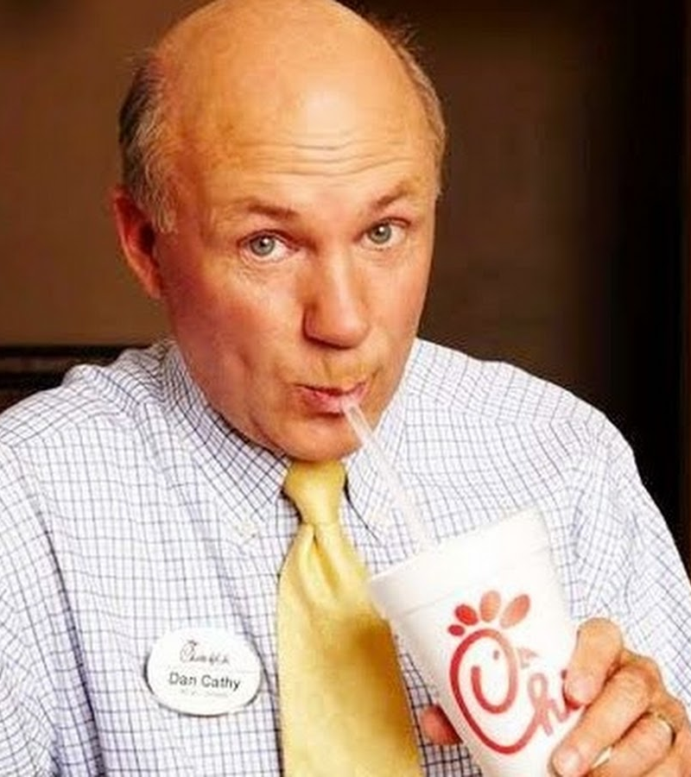
Empathy
“Every life has a story, and often our customers and our employees, need a little grace and a little space when you deal with them because they are either experiencing a problem, just finished having a problem, or are about to have one,”
- Dan Cathy, Chick-fil-A CEO
Notes:
What sticks out for you?
Empathy is the ability to sense other people's emotions, coupled with the ability to imagine what someone else might be thinking or feeling.
Be Present
Listen and let the person know that they are heard
Because every interaction is Unique

Slide 26
Oh, what a feeling
THRIVE Customer Service
Notes:
A. Can make up scenarios for each feeling and assign each feeling to a group.
Divide the class into 5 groups. Assign each group a picture. They should act out the scenario and present it to the class.
The objective is to use EMPATHY AND RESPOND WITH MYRA’S 3R’S.
Each scenario should only be 2-3 minutes.
Now put each group into a breakout room to name the feeling and come up with their scenario. Give them 15-18 minutes to name the emotion, create a scenario and practice it.
After the set time expires bring the groups back and listen to the scenarios.
When the groups return debrief with:
When you empathize, the end result is it leads to increased client satisfaction even if you can’t solve the problem. Taking the time to make a person feel emotionally understood is a viable part of showing care. 2 min.
Expressing empathy is a way of showing you really understand their frustration and you really care about helping.

Slide 27
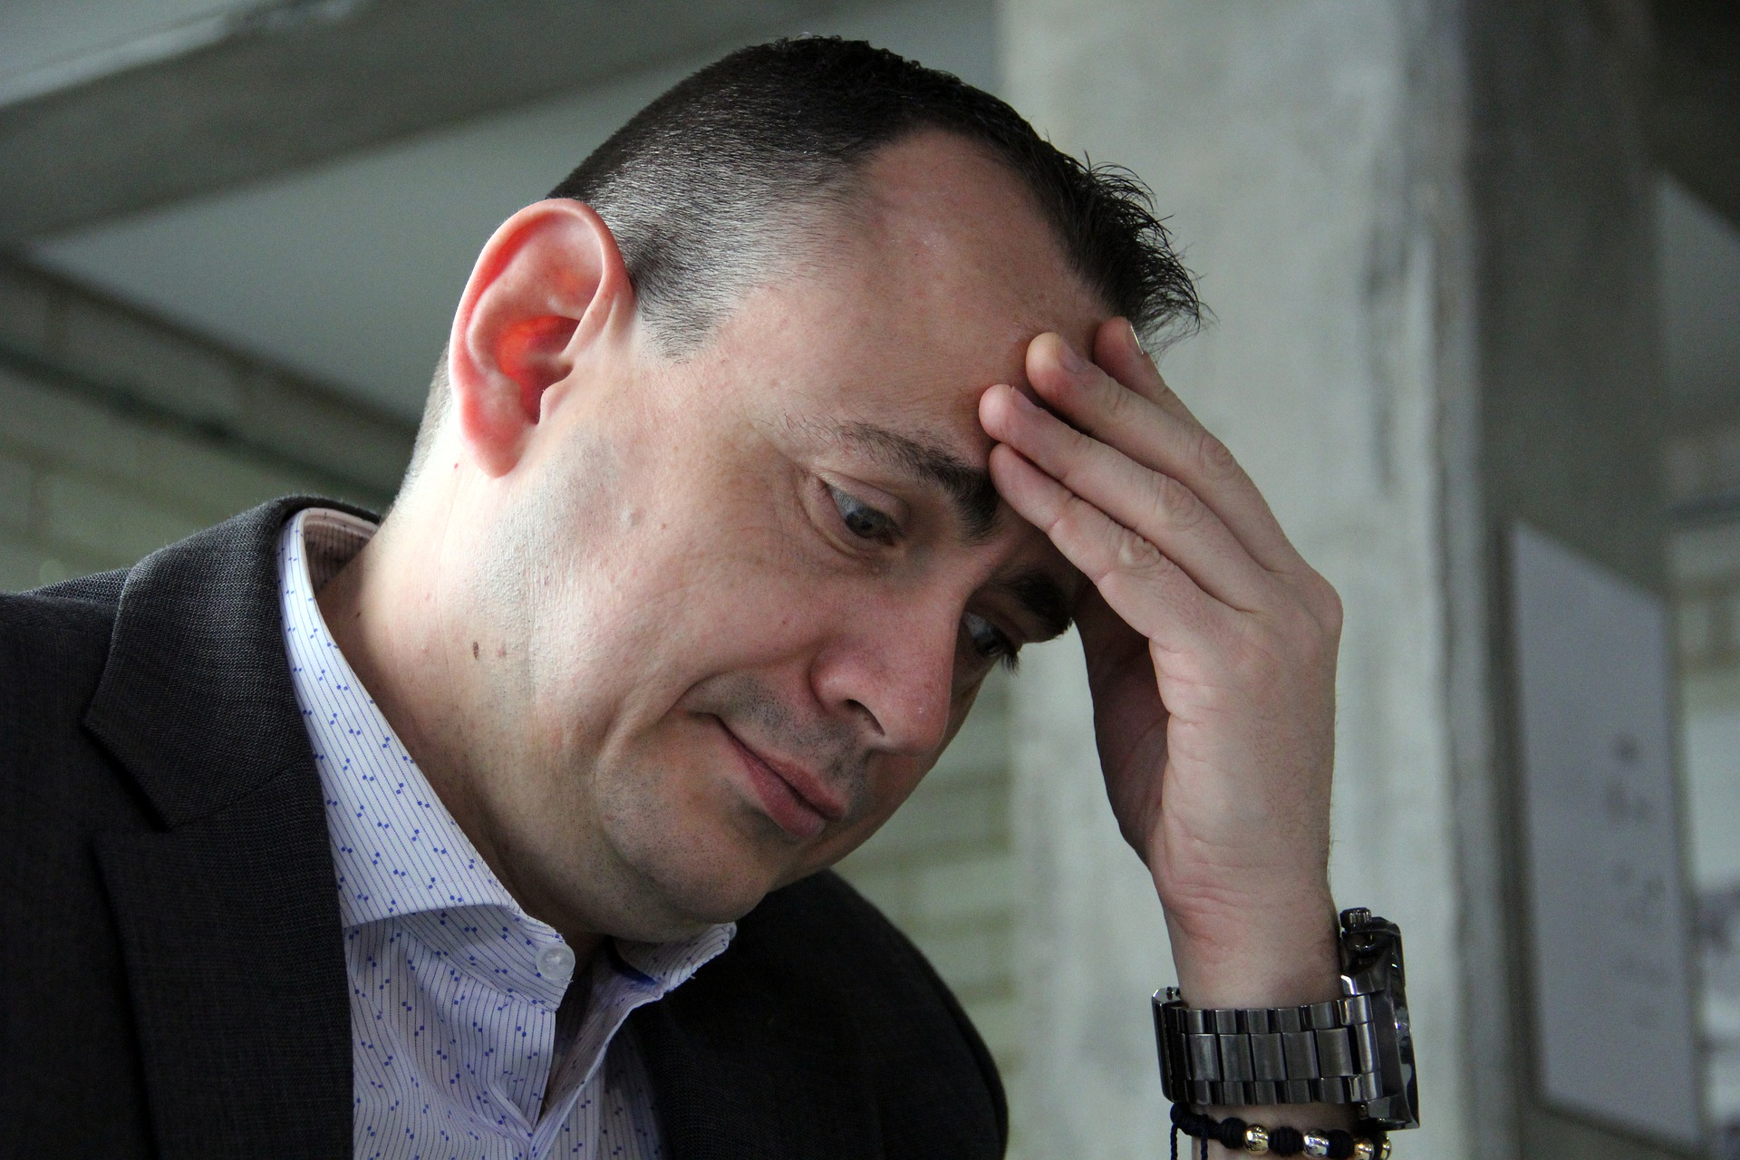
Name This Feeling
2
1
5
3
4
THRIVE Customer Service
Notes:
Debrief – One thing you would say

Slide 28
EMPOWER
WORK TOGETHER AS ONE
Notes:
EMPOWER
WORK TOGETHER AS ONE is the 4th Core Value at Osaic
We are collaborative and diverse, and better for it.

Slide 29
Create A Win-Win
“No matter what type of services you provide, creating a high-quality experience for your customers is ultimately what will keep you in business. By helping clients feel truly empowered when they work with you, you can improve satisfaction and retention rates, while also ensuring that you are fully meeting their wants and needs.
When you empower your clients, you will end up making your job easier, because you’ll better understand how to serve them. That’s going to pay big dividends in the long run.”
Forbes : How To Empower Customers (Without Losing Control Of Your Business)
THRIVE Customer Service

Slide 30
Empowering Our Customers
Satisfaction
Loyalty
Retention
Your Job Easier
THRIVE Customer Service

Slide 31
CONCLUSION

Slide 32
Takeaways
Introduced of the new THRIVE Customer Service Training.
Identified and Connect the principals of THRIVE to internal and external clients.
Practiced using THRIVE to empower your team to thrive.
THRIVE Customer Service

Slide 34
Appendix

Slide 35
Activities
Slides 9-12 Group activity – get up as a group and use poster paper
Slide 14 Class activity
Slide 20 Group activity
Slide 24-25 Group activity

